Slide 1
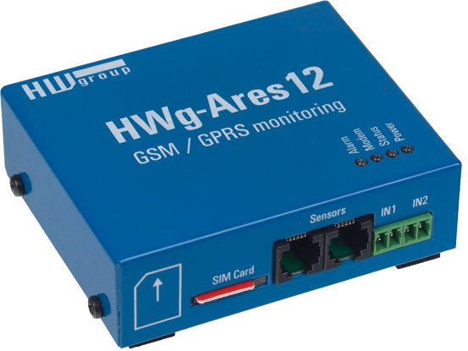


HWg-Ares: GSM/GPRS now available
HW group GSM/GPRS monitoring.
HWg-Ares 12 / 14

Slide 2
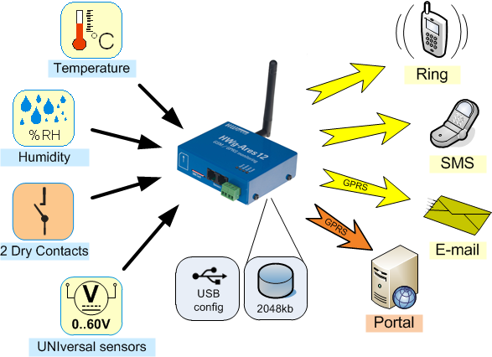
HWg-Ares: GSM Thermometer

Slide 3
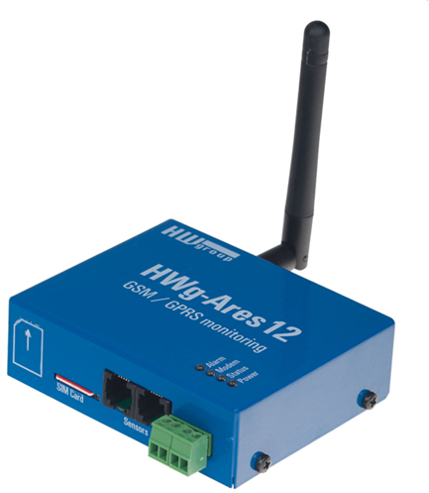
HWg-Ares: Basic features
GSM/GPRS device for remote monitoring
Can be connected to SNMP systems (Nagios)
Internal Li-Ion battery for 10 hours backup
Ready for global GSM usage (Quad-Band)
External sensors for temperature, light, voltage, humidity, current, dry contact & other.
  Windows software for data collection available (HWg-PDMS)
  Alarms by SMS, Email (GPRS), HWg-Push
  USB or FOTA (Firmware Over The Air) FW upgrade
Notes:
Zjednodušené features

Slide 4
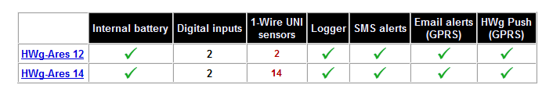
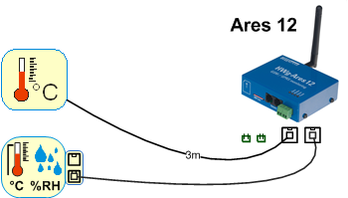
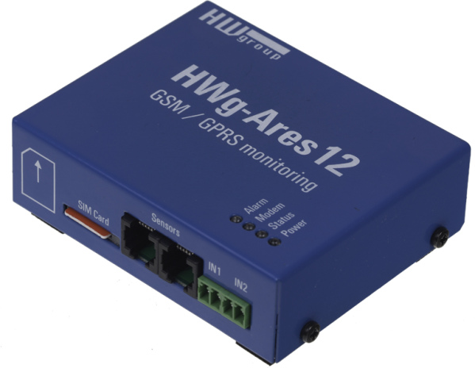
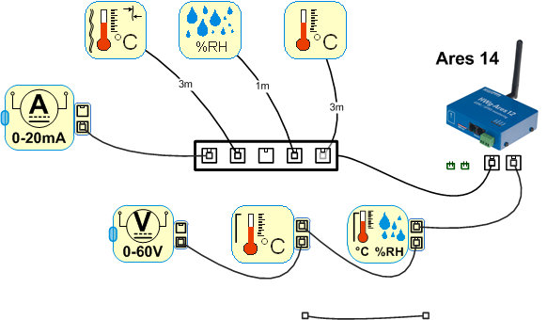
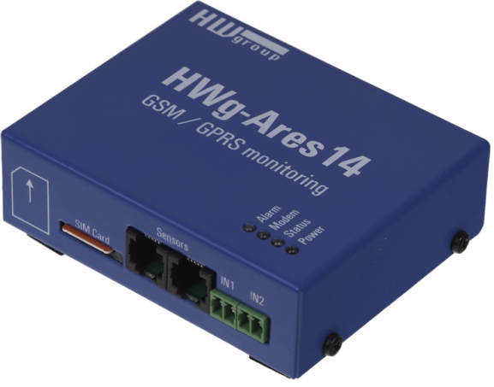
HWg-Ares 12 / 14
3
14
3 sensors
14 sensors

Slide 5


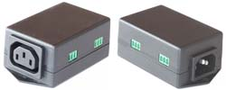
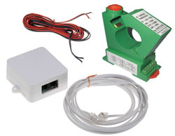
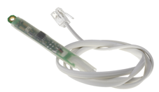


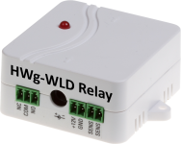
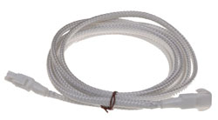

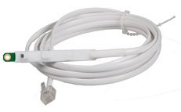

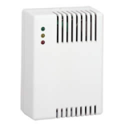


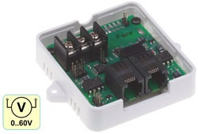

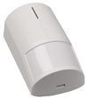

Sensors overview
Temperature, Humidity
Water Leak, Voltage, Light, Power, ..
DI: Smoke, Doors, AirFlow, Water, ..
3rd party sensors:
4-20mA => 1-Wire UNI
0-60V DC => 1-Wire UNI

Slide 6

HWg-Ares: Applications
Wind Mill
generator
Data Centre
AirCondition
Remote telco
site (BTS)
Remote genset
Diesel generator
Remote machine
Remote monitoring without accessible LAN
Back-up power & Diesel generators monitoring
ATM machines monitoring
Technology along roads, highways, or railroad tracks
Food / medical storage & transport
Electricity distribution networks (transformers, power-lines)
Water source & technical equipment status monitoring
Remote water
drill

Slide 7
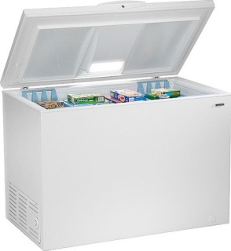


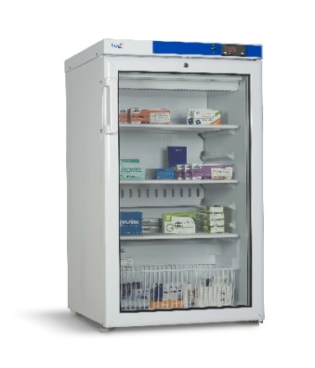




HWg-Ares: Power & Temperature
SMS Power failure
GSM/GPRS
Email Power failure
█ ON
█ OFF
Sensors powered from the battery.
4 hours later
Temperature Alert
Temperature sensors
█ ON
█ OFF
Battery backup
for 4-12 hours
█ ON
█ OFF
Power
HWg-PDMS: graphs

Slide 8




HWg-Ares standalone usage
SMS septic tank full
Power
SMS
septic tank
Owner of the building
Water waste transport service

Slide 9



HWg-Ares for service providers
GPRS
Monitoring service
Operator
Monitoring software

Slide 10
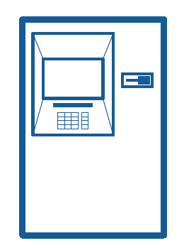

Multiple point monitoring system
Operator
Local service
Temperature
ATM
Cash machine
Vandal detector
Security
Power
Alert
GPRS
Monitoring software
For several sites you have to use central Monitoring.

Slide 11
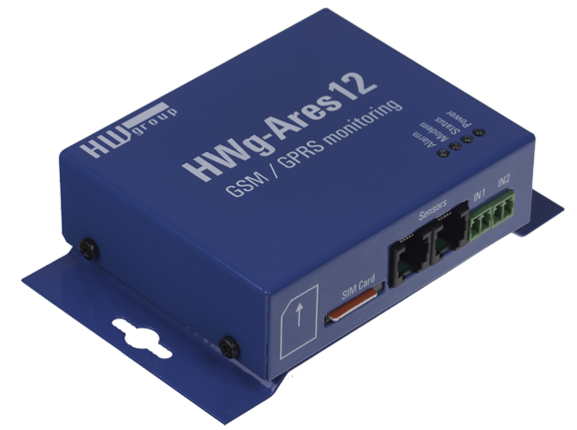
Contact us
www.HW-group.com
Video about HWg-Ares 12
HWg Ares 12 product page

Slide 12
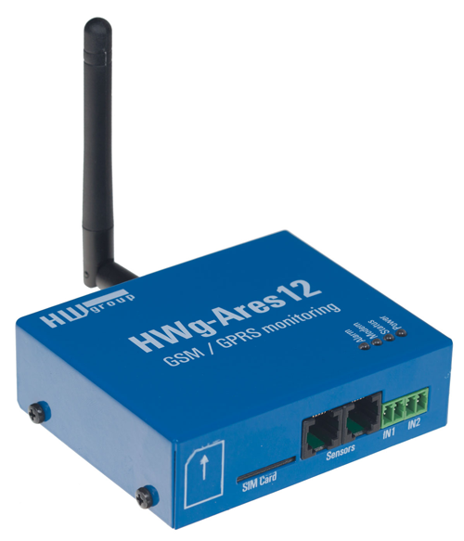
HWg-Ares: GSM/GPRS monitoring
HWg-Ares 12: GSM/GPRS Thermometer with internal battery.
Email/SMS alerts to 5 destinations. Free software, data connected to the Web portal or SCADA/SNMP systems.
Internal battery
Comfortable USB configuration
Remote firmware upgrade (FOTA)
HWg-PDMS compatible
HWg-Ares is ready for data transfer over IP (GPRS) to 3rd party systems.
Internal version
For partners only..

Slide 13
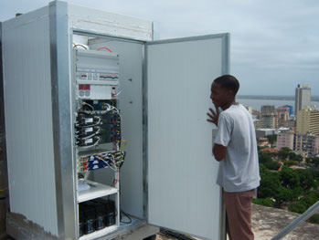



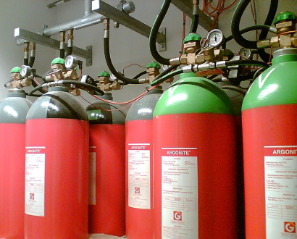


HWg-Ares = Remote Applications
Standby electrical generator monitoring
Remote infrastructure
Hub sites monitoring
SMS
GPRS DATA
-48V DC power system monitoring
Fire suppression system remote monitoring
GSM phone
Monitoring center

Slide 14
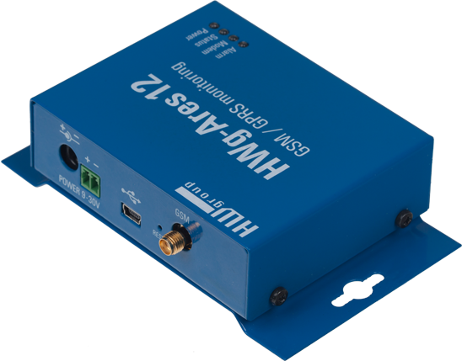
HWg-Ares12: Basic features
GSM/GPRS: Quad-Band 850/900/1800/1900 MHz
Internal Li-Ion battery: (4-12h)
Digital Inputs: 2 DI (dry contact)
Sensors: 2xRJ11 (1-Wire UNI)
  Alarms: SMS, Email (GPRS), HWg-Push
  Protocols: SMTP, NTP, HWg Push (http)
  Diagnostics: External power, battery status [%]
  Flash log: 2 Mb / 170.000 records - (e.g. 3 sensors @ 5 mins = 200 days)
  Logfile attached to email or available over USB
  FW upgrade: USB or FOTA (Firmware Over The Air) over GPRS
  HWg-Ares 12: 3 sensors
  HWg-Ares 14: 14 sensors
Notes:
Zjednodušené features

Slide 15
HWg-Ares12: Extended features
Authentication STARTTLS supported by Ares.
Some SMTP servers requires it (Gmail for example)
Roaming detection can disable GPRS connectivity, while Ares is out of domestic GSM network. SMS still available.
5 recipients for email even SMS solving all potential situations.
SMS alert can be followed by ringing to the alarm number.
Event macros enable user definable text for every situation to email and SMS.
SMS request (Phone >> Ares) enables status requests and multiple devices communication (remote FW & config upgrades).
Compatible with HWg-PDMS software (Email or HWg-Push).

Slide 16




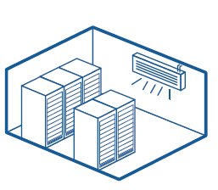

HWg-Ares: SLA Applications
Vending machines
Industrial machines
Food storage
Masage chairs
Remote genset / Diesel generator
Air Condition

Slide 17

HWg-Ares12: Business message
The Ares is nice product for the End Users. They will love how it’s simple. But it’s not our customer.
The System Integrators are the right customers for the hundreds remote sites projects (GSM & LAN mixed).
Pilot project can start tomorrow
with HWg-Ares and connection to
the HWg-PDMS software
over Email.
That’s opening new markets..

Slide 18
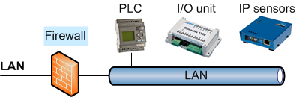
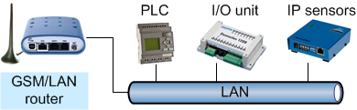
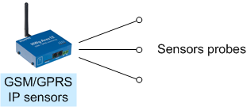
HWg-Ares: What’s a difference?
One remote sensors point is much cheaper now.
That is opening new options.
A)
B)
C)
  Installation: 1.500€ (router + Poseidon)
  GSM Fees: 40 € / month
  Installation: 650€
  GSM Fees: 12 € / month
18
18

Slide 19
HWg Monitoring = SYSTEM
Email/SMS
HWg-PDMS
Nagios (3rd SNMP)
# Sensdesk portal
# Concentrator
# Android tablet
HWg sensors
3rd party sensors:
  4-20 mA
  0-10V
  DI
LAN
  Polling (Q/A)
  Push/Email
GPRS
  Push/Email
(1)
Data input
(2)
Processing
(3) M2M transfer
(4) SW Application
Measure (°C, V, mA, %RH, Pa, Hz, m)
Input / Output
Log, Analyse
Alert
Several models
HWg SDK
XML / SNMP
GPRS / SMS
Graph, Excel
Relay, Camera
Alarming

Slide 20

HWg-Ares: Battery inside
Internal Li-Ion accumulator supply
device and 1-Wire sensors for 4-12 hours.
Depends on the GSM usage and sensors.
To have battery integrated in similar device
is quite unique on the market.
GSM communication works even without battery.
Ares battery system is designed to 10 years usage.
Battery capacity is “standard sensor” = alerts..
External power On/Off is “standard DI sensor” = alerts..
Simply alert to power failure immediately. No UPS etc..

Slide 21
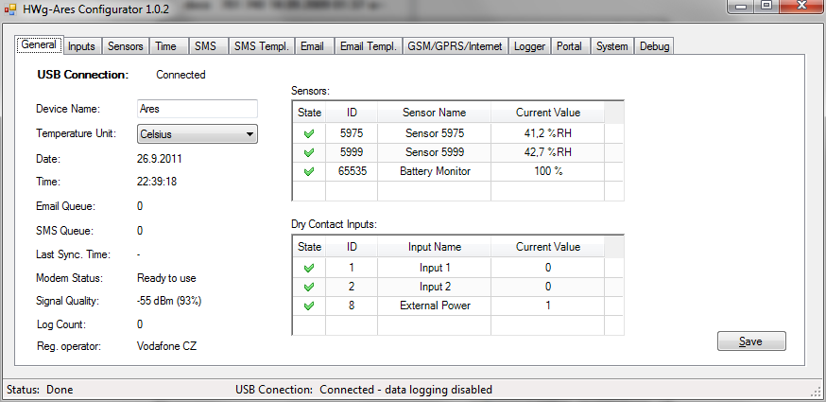
Ares: USB configure software
Configuration software appears as the file on the USB flashdisk. No installation.

Slide 22
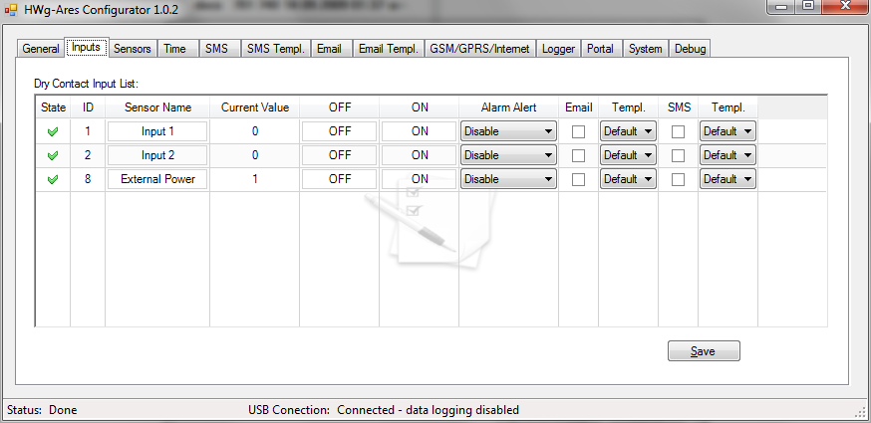
HWg-Ares12: Power failure alert
External power connection is indicated as a DI sensor. Can be alerted from internal battery..
Empty / Full

Slide 23
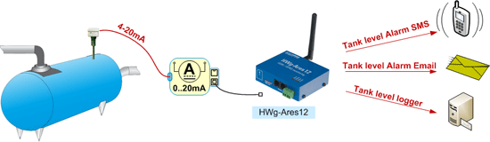
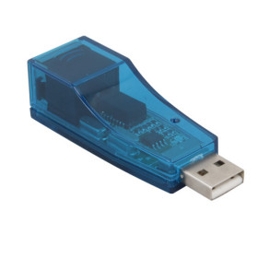
Remote Diesel tank monitoring
HWg-Ares12 supports all 1-Wire UNI sensors (4-20mA / 0-60V).
4-20 [mA]
0 - 6 [m] wanted
Dongle to calibrate 4-20mA converter (8 points, exponent, units) in PC software.
For example:
4mA = 0.2 m, 18mA = 6.0 m
For Diesel tank monitoring we
can help you offer solution. Ask for more..

Slide 24
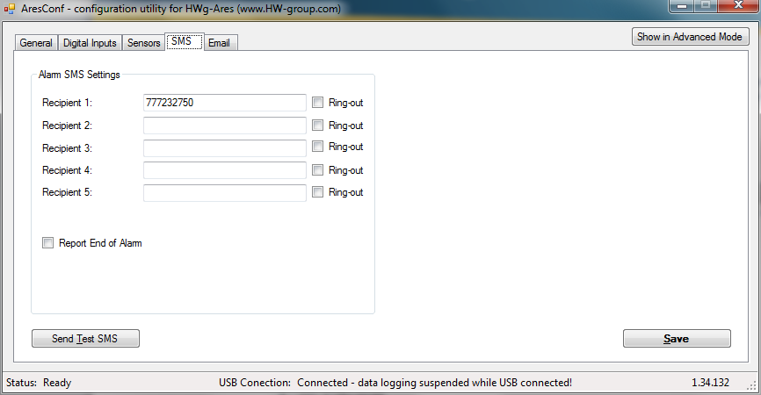

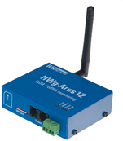
HWg-Ares: State SMS
Check if your mobile number is in the SMS Alert list.
Ring from your phone to the Ares’s number. It’ll refuse
the call and send you back the STATUS message.
SMS commands:
STATUS SMS
STATUS EMAIL
RESET
DEBUG
UPGRADE
STATUS PSW
STATUS sms
Ring
STATUS: Hallo, I’m still alive ☺ Your Ares
STATUS sms

Slide 25
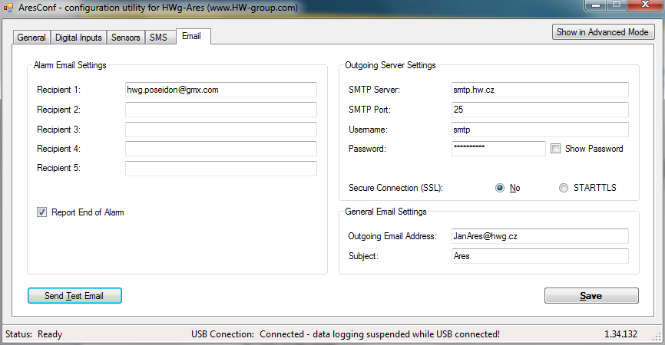
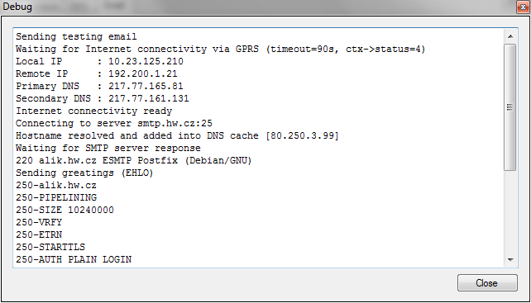
HWg-Ares: Debug window
Debug window can be shown on request:

Slide 26

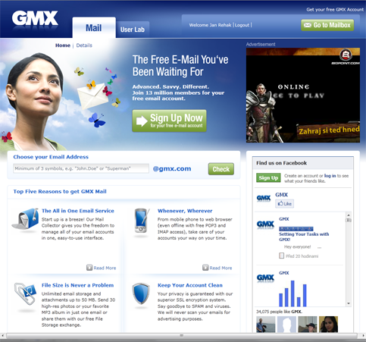
HWg-Ares12: Tips & Tricks
You can use SIM card with PIN,
but we strictly do not recommend it.
How to switch device off?
Switch off external power, push out the SIM card.
Until external power connected, device is switched off.
Why I prefer gmx.com for emails?
  Unlimited email storage
  Wide options for email filtering/forwarding
  Not require TSL Authorization

Slide 27
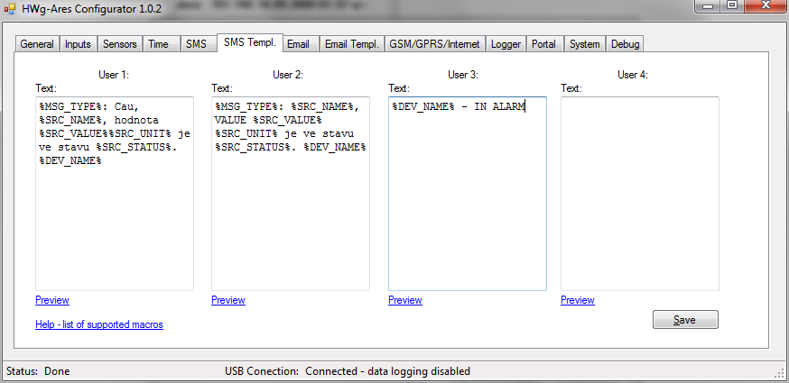
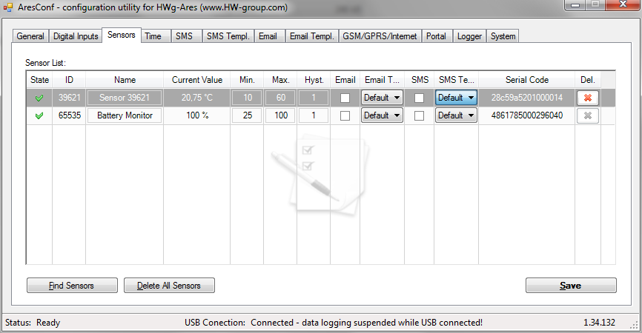
HWg-Ares: Macros
With Ares can user define 4+4 macros for SMS and Email alert texts. Assign than defined macro per DI or Sensor alert (Advanced mode).

Slide 28



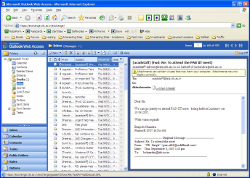

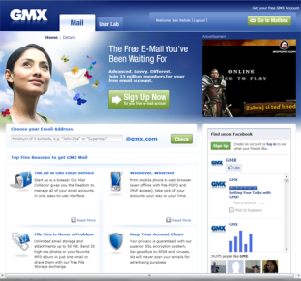
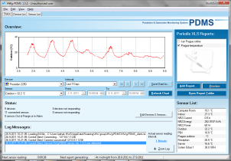


HWg-Ares: Communication options
GSM -> GSM
5x SMS + Ring
Phone ring
GSM -> GSM
SMS request
GSM (GPRS)
5x Email (SMTP)
GSM (GPRS)
HWg-Push
GSM (GPRS)
HTTP based protocol
Periodic Email
Logfile attachment
>>
HWg-PDMS
central data collector
Mail (Webmail)
HWg-Push server

Slide 29
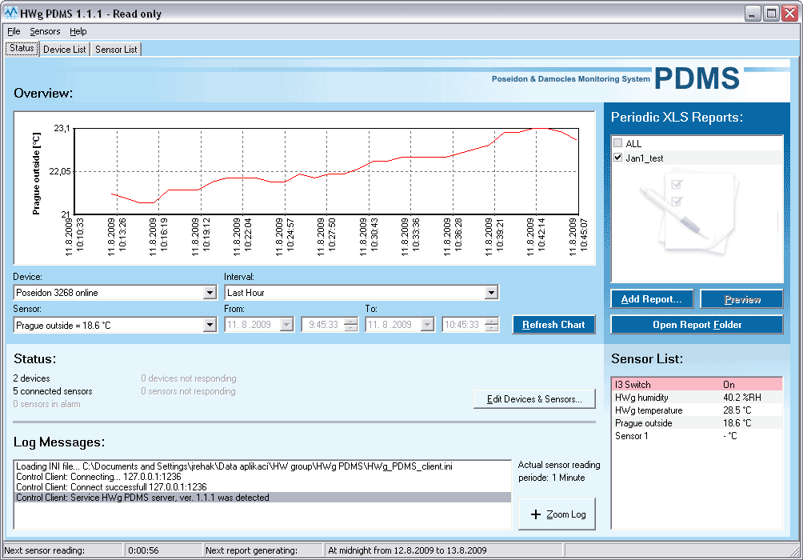
HWg-PDMS: Free software
Ares Data input:
  Email (pop3)
  Portal (HWg-Push protocol)
Data output:
  Graph in GUI
  MS Excel export / XML database
  Email report
Application: MS Windows, NT service (working on background, servers)
License: Free for 3 sensors / paid version for 8 / 20 / 250 sensors
MS Excel export: periodical on background, MS Excel 2007 compatible
More on the HWg-PDMS Webinar..

Slide 30
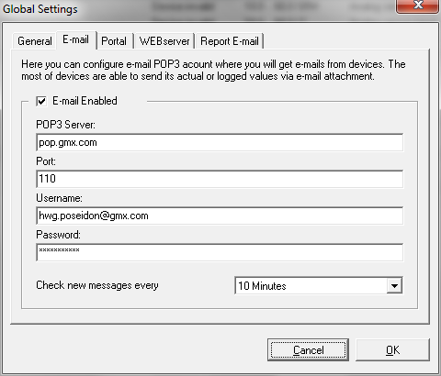
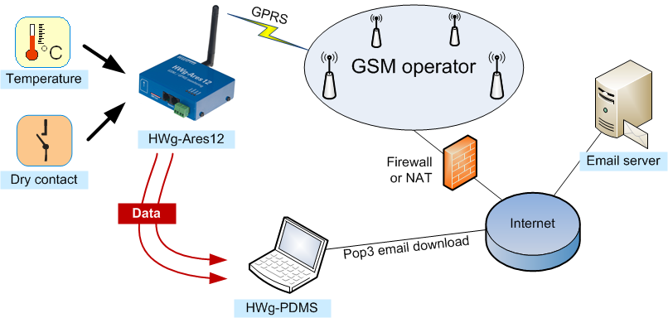

HWg-Ares12 & PDMS (POP3)
HWg-PDMS downloads data from GSM device though email account (GMX.com).
Dedicated email. One account for one HWg-PDMS installation.
POP3 is deleting emails.

Slide 31

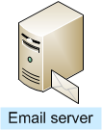




HWg-Ares12 & dedicated PDMS email
GMX can easily forward data by rules between accounts..
A:
Home computer
Data from A + B + C
B:
Notebook
C:
Data from A + B
GMX is able to forward emails from some devices to second email account.
It’s saving GPRS data transfer costs.

Slide 32
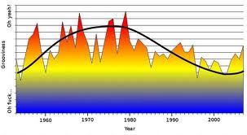
HWg-Push protocol
Communication is initiated by the sensor every time
Data pushed “as browser” HTTP, port 80
IP sensor pushing periodically data to the central portal server (default each 15 minutes).
“Auto Push” within 1 second when value
changing too fast..
HWg-Push do not require public IP address for sensors!
(Server have to be placed on the public IP address).
IP sensor with HWg-Push can be installed anywhere.

Slide 33
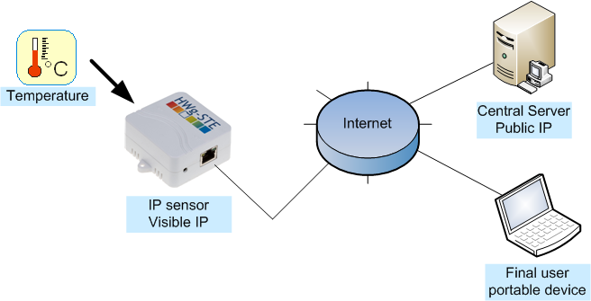

Standard SNMP (Q-A port 161)
1) Question
2) Answer
Have to be configured
IP sensor have to be on public IP address
NAT or Firewall have to be configured by IT dept.

Slide 34
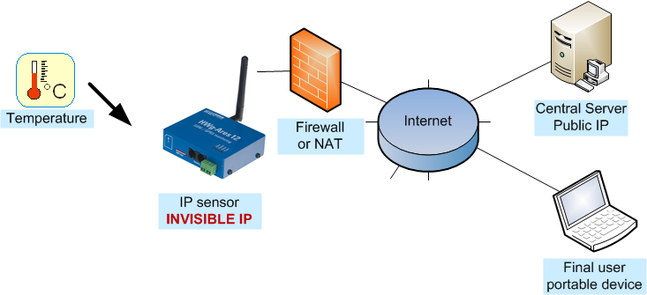
HWg Push protocol scheme
HWg Push plugin
2) Auto Push with value peaks
1) Push data each 15 min
No configuration required.
Push data via HTTP, (REST protocol). Like the web browser.
Central server have to support “HWg Push” protocol.
IP sensor can be pre-configured and sent by post box
(DHCP enables simple installation for LAN sensors)

Slide 35


HWg-Ares: Nagios plugin
Nagios is most popular free SNMP Monitoring software
HW group will present Nagios plugin during 2Q 2012
Available for free in source codes too..

Slide 36














HWg-Ares over SNMP = Concentrator 4Q 2012
HWg-Tg11
HWg-WLD
HWg-Ares12
HWg-STE
HWg-Ares20
Poseidon
HWg-AresXX
GSM
GPRS (3G)
Damocles
HWg-PWR
Generic SCADA
(Modbus/TCP or XML)
HWg-PDMS
HWg
Concentrator
HWg Online portal
Sensdesk.com
Generic NMS
(SNMP)
Sensors list
SNMP & Modbus/TCP

Slide 37

HWg-Ares: Web portal
HW group will present in 2Q it’s own fully free web portal for the Ares data collection. It’ll be EXAMPLE not competition for the 3rd party solutions.

Slide 38

SensDesk.com: web portal (cloud service)
Online portal (cloud service), monitor your sensors without any software just online portal.
Central storage for all data & values, Graphs of values & data export
Free web service for HWg Push devices
(HWg-Ares, HWg-PWR, HWg-STE Push).
One click installation with default HWg-STE Push device
Will be ready in June 2012 (Provided by HW group itself)

Slide 39

SensDesk user account

Slide 40



HWg-Ares: Other technical notes
Power Jack + Terminal block
Ext. power 9-30V DC enable industrial usage
USB is for configuration only.
(No power from the USB interface.)
DEVICE RESET
Most easy to reset device on the table is to plug in-out the SIM card. It’s SW reset. HW reset is button next to GSM antenna (You’ll need pen or wire to push it).

Slide 41


HWg-Ares: DIN / Wall Montage
HWg-Ares 12 plain unit
HWg-Ares 12 bulk
Plain unit + “Mount plate type D”.
HWg-Ares 12 Tset
Plain unit + “Mount plate type D” + sensor + 4band antenna + adaptor..
Standard DIN RAIL holder can be
screw on HWg-Ares plain unit.
DIN RAIL holder can be rotated as you wish.

Slide 42



HWg-Ares: Price definition (RWP)
Poseidon 2250 GSM Tset = 746 €
Poseidon 4002 Tset + GSM = 1143 €
HWg-Ares 12 plain = 480 €
HWg-Ares 12 Tset = 549 €
HWg-Ares 14 plain = 650 €

Slide 43
HWg-Ares: Price argumentation
Why the HWg-Ares do not cost 100€ ?
Device with Battery inside, 10 years and not for 3 years only
You can buy sensors & SW from us =
Ares is a system, not just device itself.
HWg-Ares is a Industrial quality = reliable product.
You can save a time. It’s very easy to use & install.
It’s ready for hundreds sites installation (FOTA).
It can be combined with standard LAN monitoring devices
(based on SNMP) & other HW group sensors.
HW group distributors provides you better service & help with system Integration than box moving companies with China’s product for 100€.

Slide 44

HWg-Ares Tset is International ready
HWg-Ares 12 Tset package can be used
all around the world, even it increase
a bit costs of the set:
4 band external antenna (3m cable)
International (EU / UK / USA) power adaptor
Tset = Temperature sensor 3m included
Mount plate type D
USB cable for configuration
DVD with PDF manuals & HWg-PDMS software

Slide 45

HWg-Ares: Marketing message
HWg-Ares 12: GSM Thermometer with Email (GPRS) and SMS alerts.
Remote environment monitoring installed anywhere you want within 1 minute.
Internal battery for several hours backup. Free software, data connected to the Web portal or SCADA/SNMP systems.
Internal highlights:
Internal battery (alert to power failure, 10 years)
Any sensor can be connected & Any software (3rd party incl.) export
Ready for hundreds sites installation (FOTA, battery, ..)
With our PDMS SW you can install pilot tomorrow!
HW group will present competition research.
NDA signed required.

Slide 46
HWg-Ares: Test by yourselves
Test the SMS functions from the Ares unit.
Simply install HWg-PDMS 2.x, make an email on the free account (www.gmx.com for example). It’ll be dedicated to your PDMS only and connect it thought POP3 account.
Enable logger for each 5 minutes.
Send log emails from the HWg-Ares unit every one hour to this email.
You should see data in the PDMS every hour.
Please test sending emails with all your local GSM operators.
Send us APN and Internet settings for all operators in your country.
For the marketing reasons, we created list:
http://www.hw-group.com/products/HWg-Ares/HWg-Ares_GSM_APN_en.html
Simply test sending email and if works OK, report us the settings.

